Slide 1


Why St. Anger is the best metallica album

Slide 2
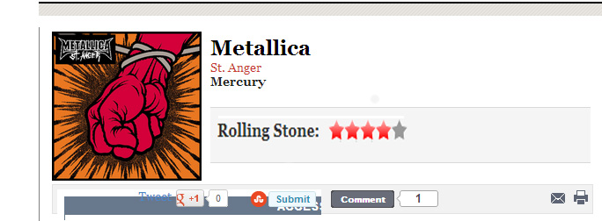
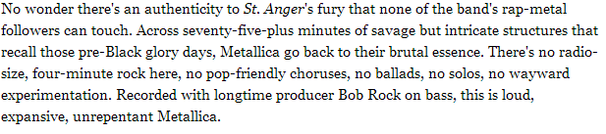

Slide 3
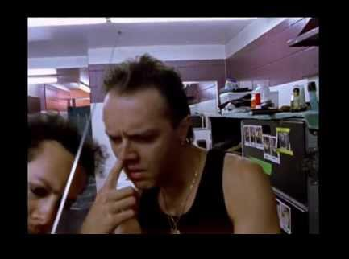
Lars Ulrich is the best drummer ever! His performance in St. Anger is groundbreaking drumming.

Slide 4
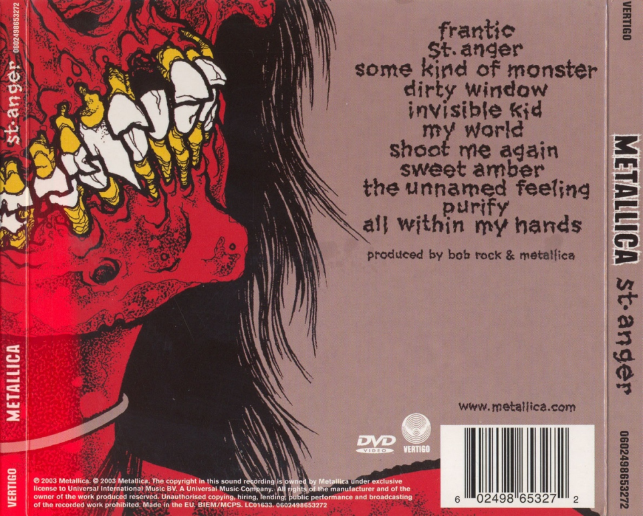

St. Anger has 11 awesome tracks with head-banging.

Slide 5

This song is one of the best songs on the album. This song makes you truly go …
Frantic

Slide 6
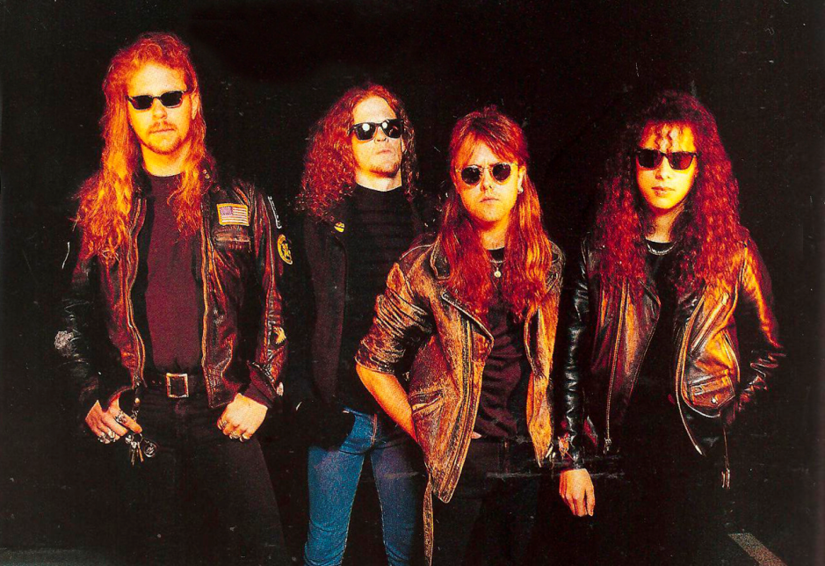
Now look at this atrocious nonsense!!!
No lyrics, just boring generic ‘80s riffs.

Slide 7

Even this guy agrees!!

Slide 8

And wait, there’s more …

Slide 9
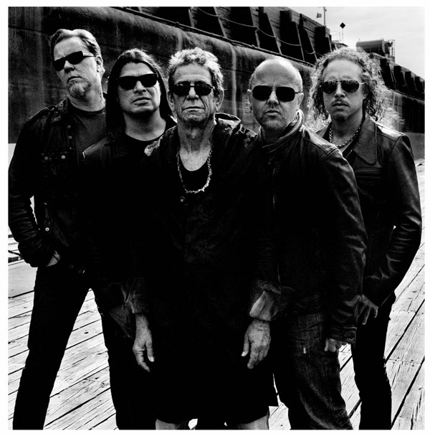
Check out LULU by Metallica and Lou Reed.

Slide 10
HERE’S A CLIP FROM AN AWESOME TRACK!!!!!!!!!

